Slide 1
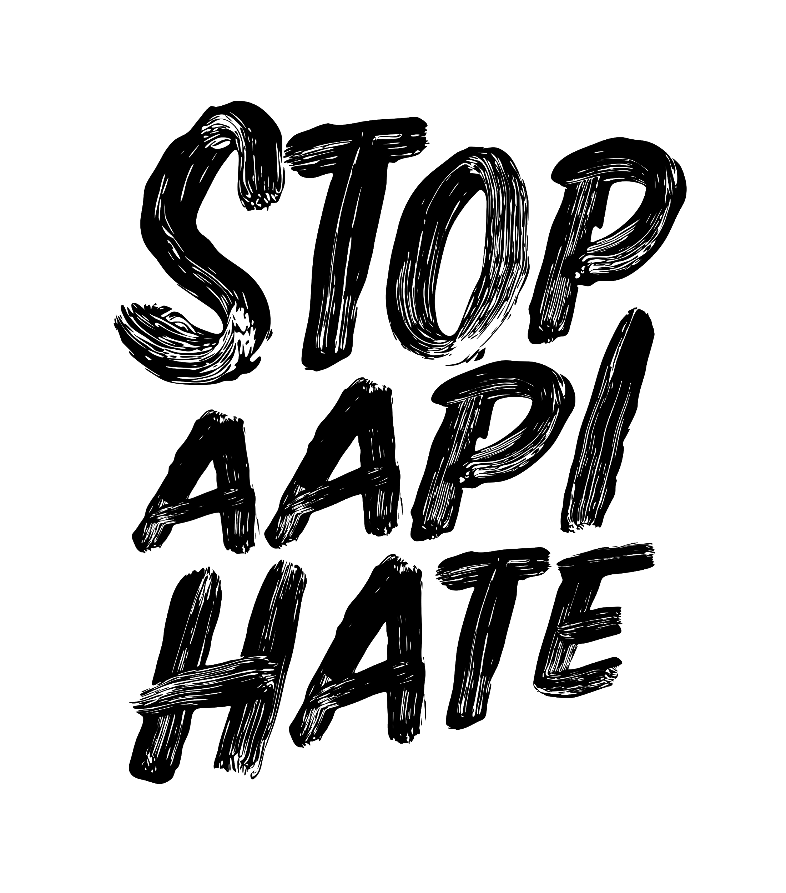
Understanding and Preventing Anti-Asian Bias
CYNTHIA CHOI & MANJUSHA KULKARNI
/ FEB 19, 2021
AN INITIATIVE BY

Slide 2
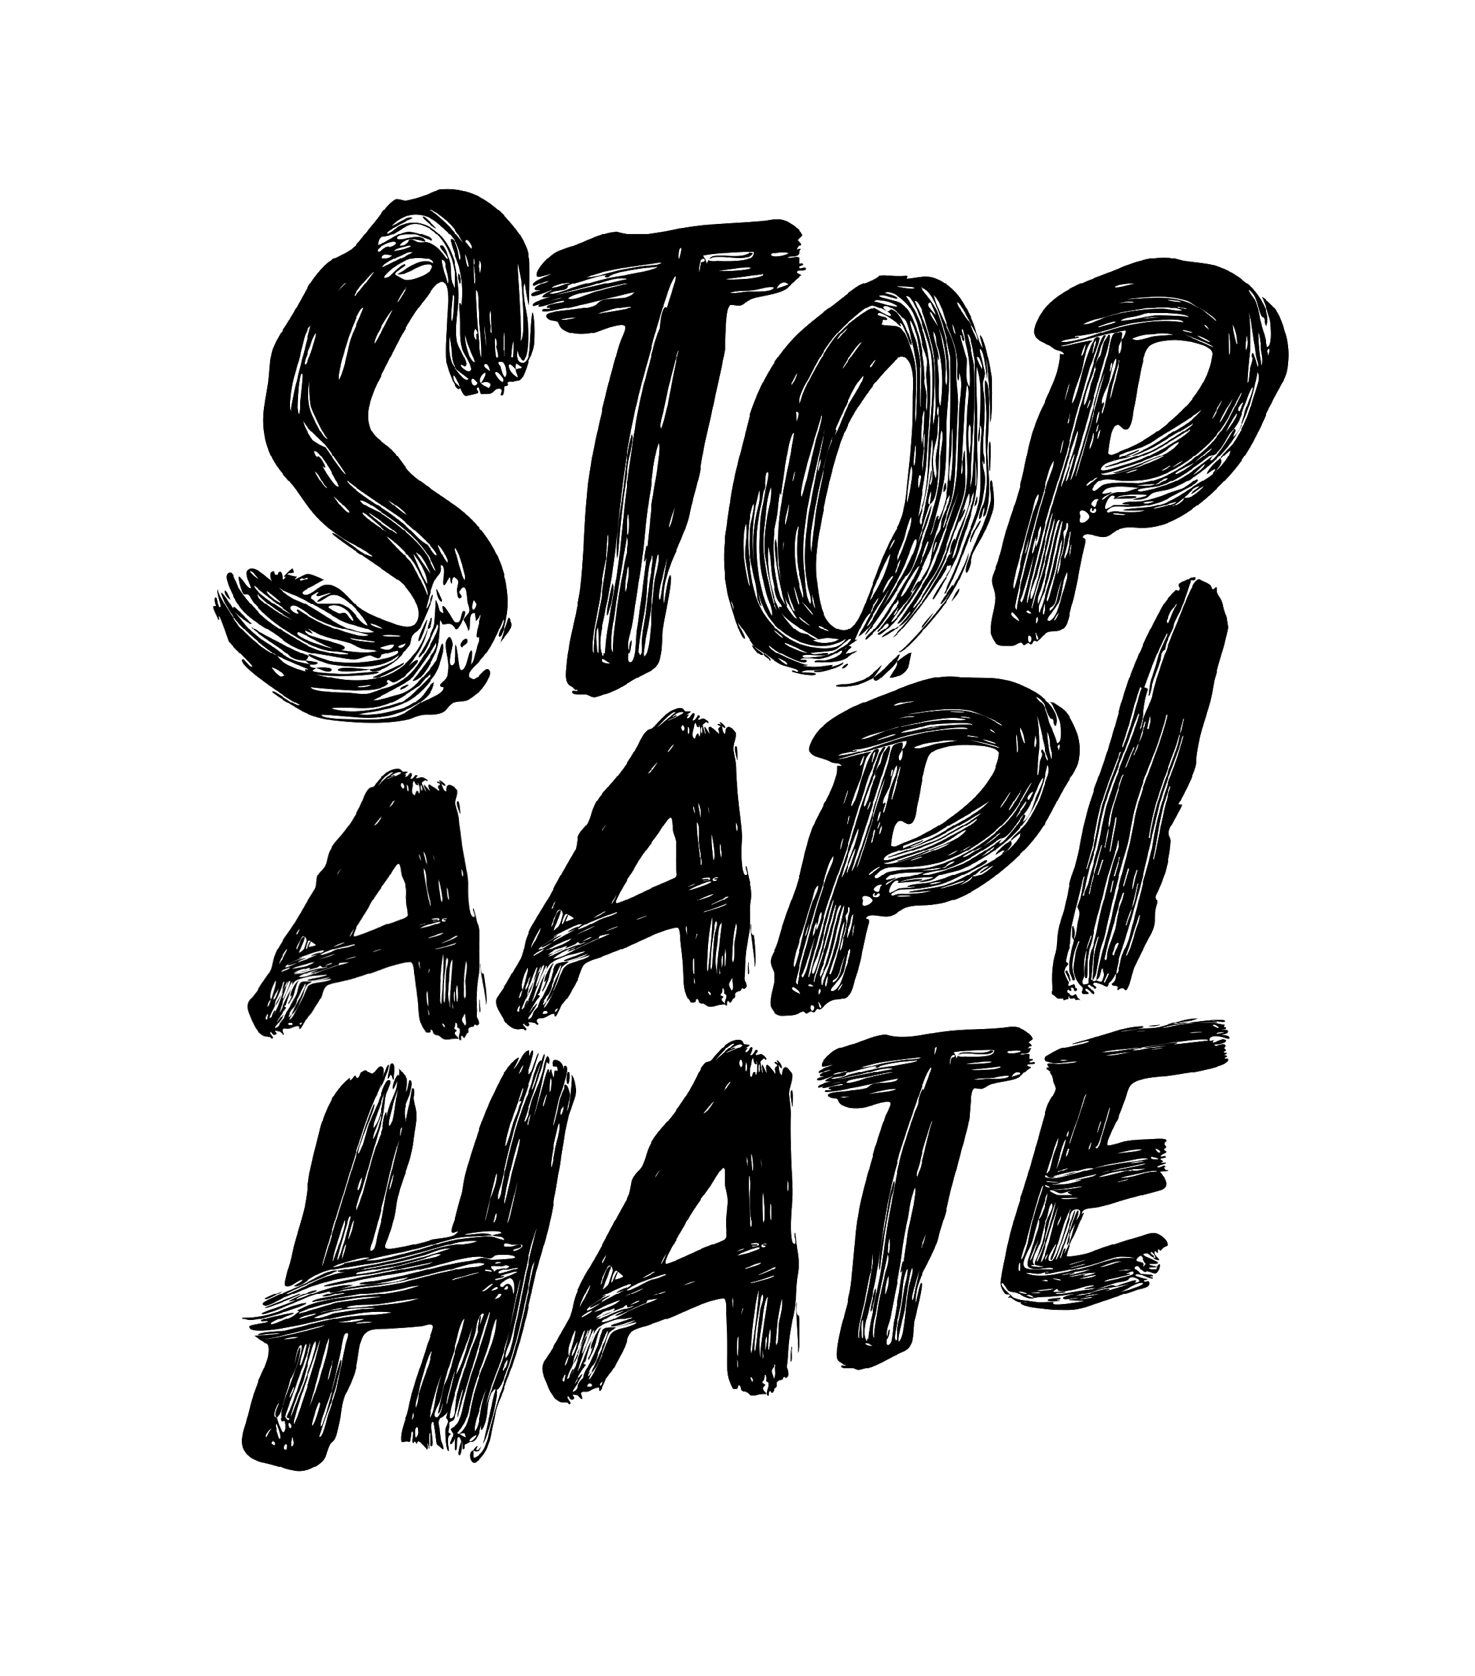
What the Surge in COVID-19 Related Racism Looks Like
“Requested a [ride-hailing service] from OAK after coming back from AZ. Driver pulled up to pick us up. Before we even opened the door, driver screamed at us, demanding where we were coming from and if we were coming from China.”
“My elderly parents were walking with my two-year-old and some 20-30-year-olds drove by and screamed “F--k China!!” at the stop light. They felt very unsafe, especially with a child.”
“African American male asked me [a resident physician] if I had coronavirus because I am Asian American and proceeded to berate me for several minutes.”
“Middle school child was physically attacked and verbally assaulted on the schoolyard. A bully accused him of having COVID-19 and told the child to go back to China. When the child responded that he was not Chinese, he was punched in the head twenty times.”
“Tech executive approached our family as we were celebrating a family birthday at a restaurant and started yelling racist remarks “F--k you Asians. Trump is going to F--k you,” and “You f--kers need to leave...f--king Asian piece of s--t.”
“White male struck me as I was walking through the aisle of a hardware store and verbally attacked me, saying “Shut up, you monkey”;F--k you, Chinaman”; “Go back to China”; and “...bringing that Chinese virus over here.”
Notes:
Could we lighten the gray background a bit

Slide 3
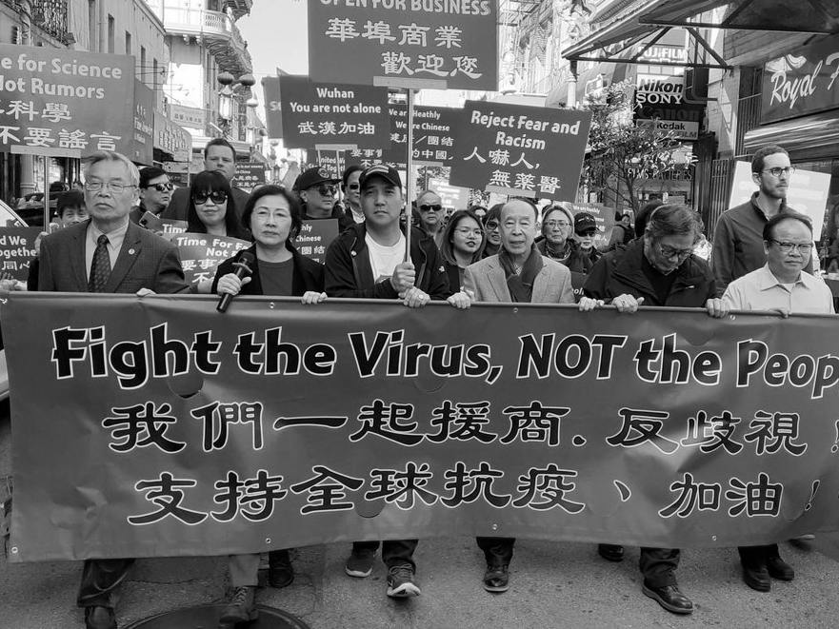
About Stop AAPI Hate
The Stop AAPI Hate Reporting Center [www.stopaapihate.org] launched on March 19, 2020
We are a collaborative of Asian Pacific Policy and Planning Council (A3PCON), Chinese for Affirmative Action (CAA), and San Francisco State University’s Asian American Studies.
All three organizations are trusted by Asian American communities and allows us to conduct outreach to low English proficiency and immigrant communities.
We have forms in a dozen Asian languages, including traditional and simplified Chinese, Korean, Japanese, Vietnamese, Khmer, Thai, Hmong, Tagalog, Hindi, and Punjabi.

Slide 4
2,808 incident reports were filed in 41 weeks.
Most involved hate incidents, not hate crimes.
Incidents were reported from 47 states and the District of Columbia.
56 percent of incidents took place in either California or New York State.
Women experience hate 2.3 times the rate of men.
Seven percent of respondents are seniors (60+).
National Data on Anti-Asian Hate Incidents

Slide 5
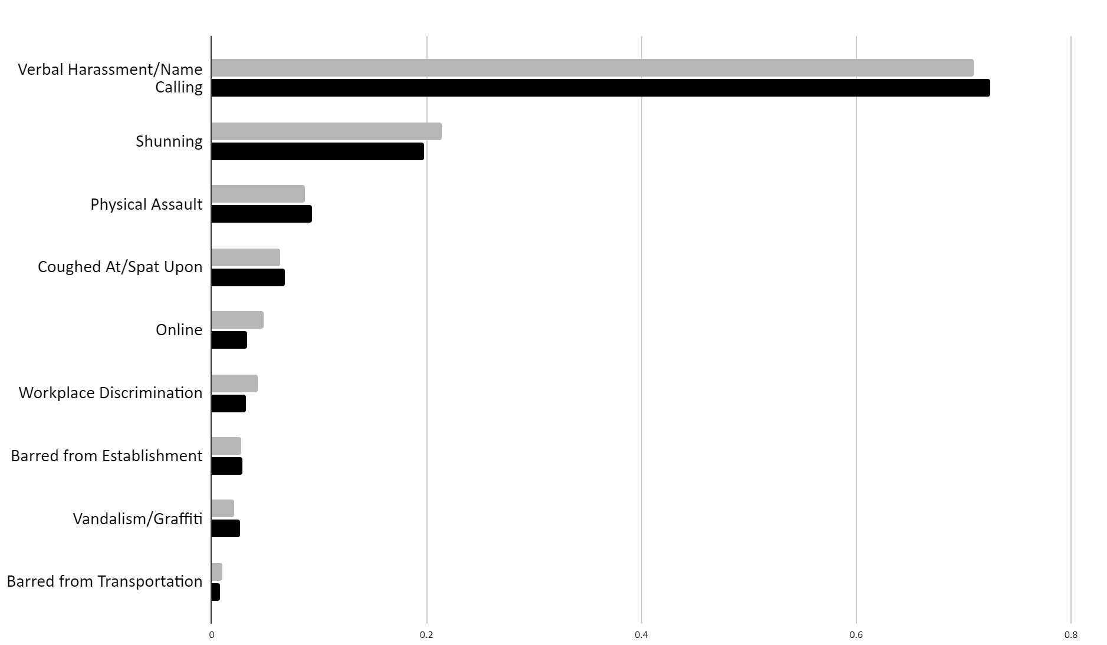
US
CA
Types of Bias & Discrimination
Notes:
Outreach to LEP and immigrant communities

Slide 6
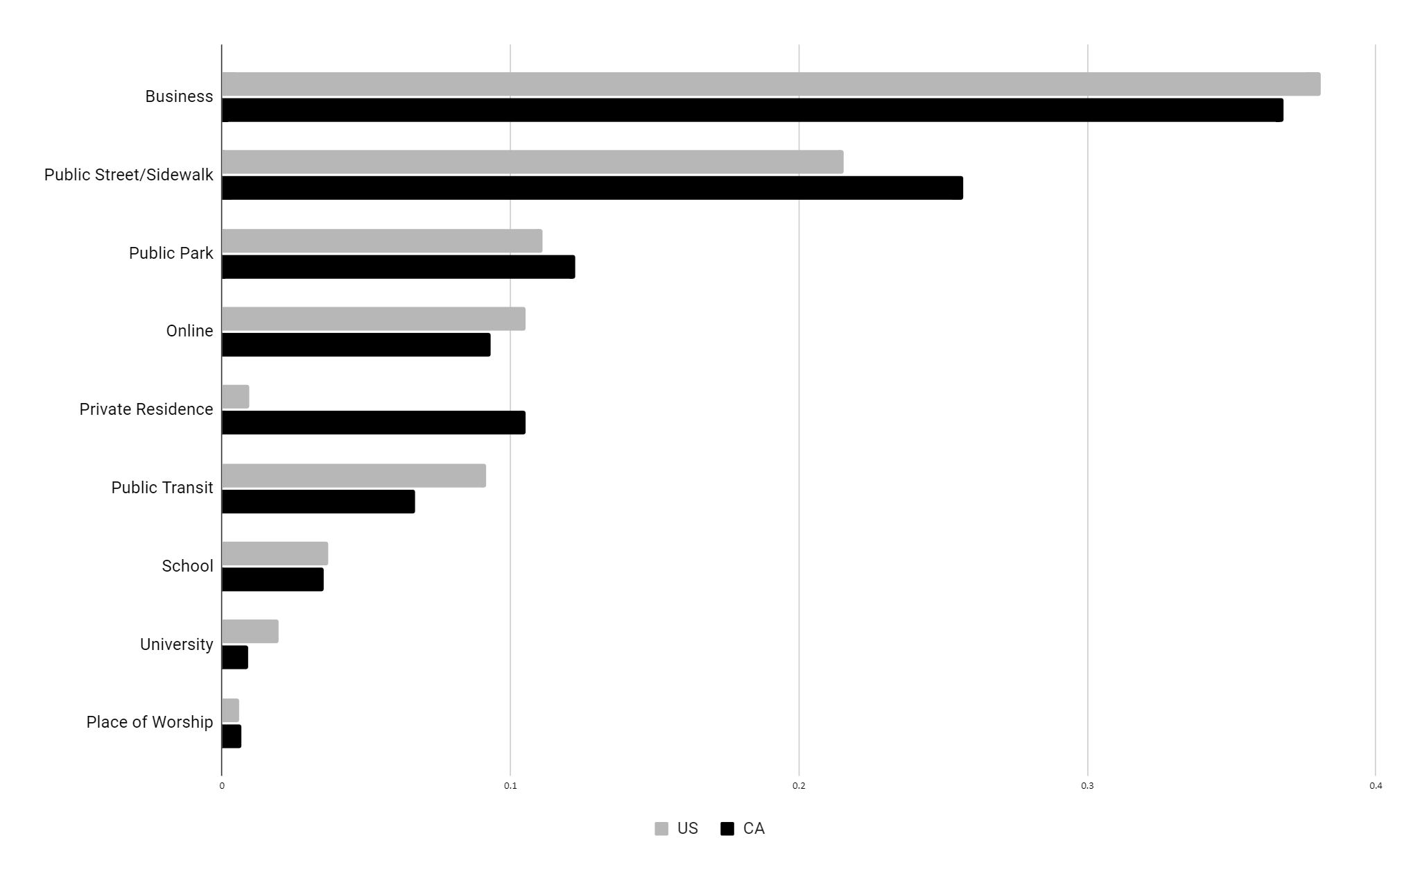
US
CA
Site of Reported Incidents
Notes:
Takeaway: businesses are the most common place for hate to occur

Slide 7
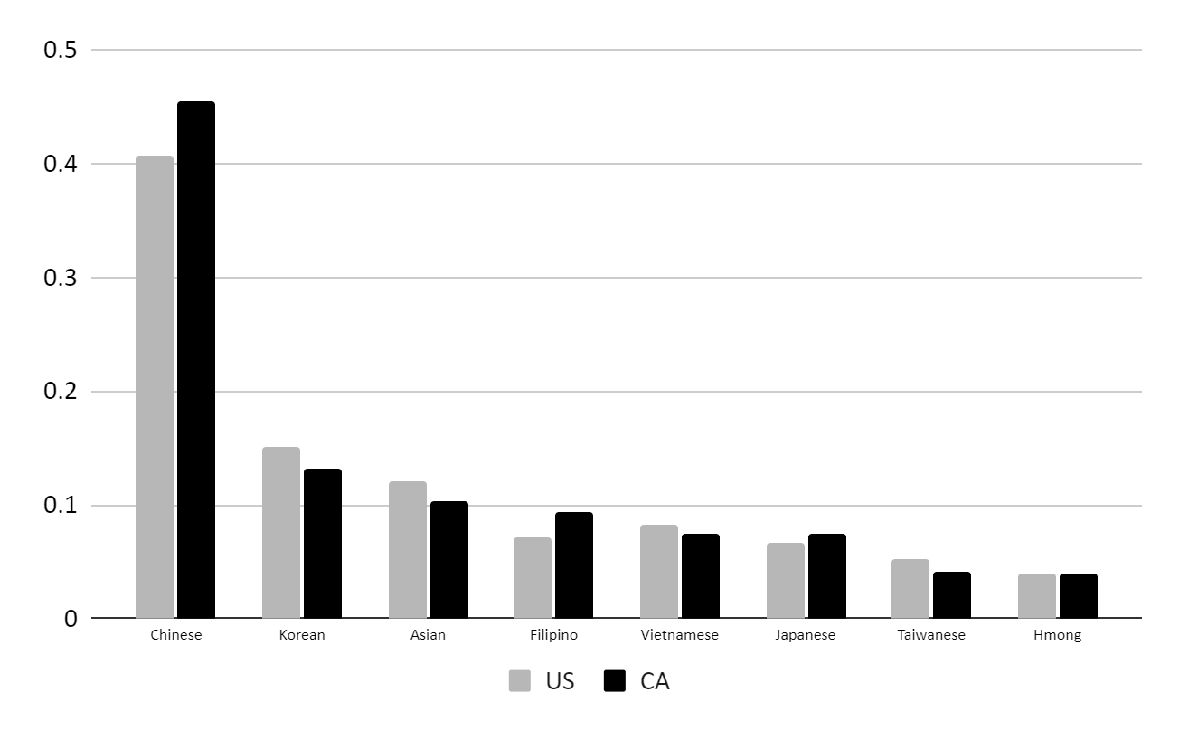
US
CA
Targeted Ethnicities
Notes:
Even though Chinese are usually the ones targeted, hate impacts all ethnic groups

Slide 8
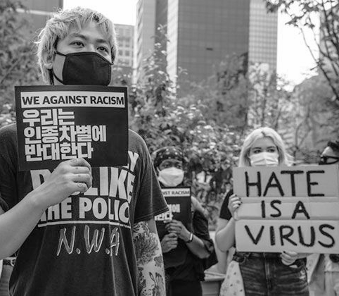
Impact of Racism on AAPI Communities
We have observed a 155% increase in depression among Asian American communities.
Asian Americans are also experiencing the second highest rate of unemployment and small business closures behind African Americans.
Anti-immigrant policy, including bans on immigration, ethnic media (i.e., WeChat), and racial sensitivity training.

Slide 9
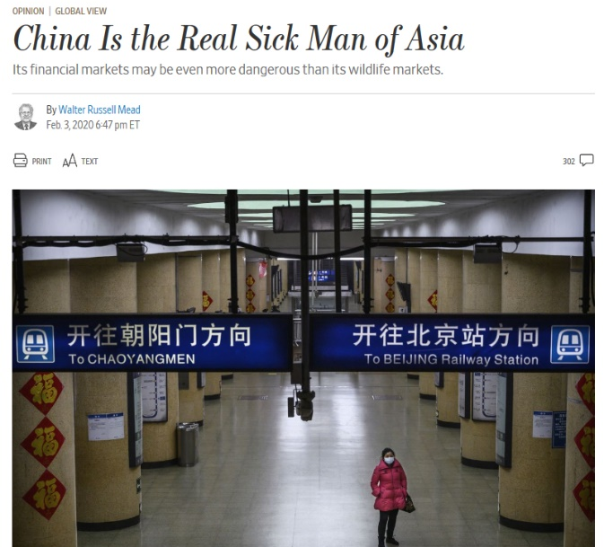
The Historical Precedent for Anti-Asian Bias & Discrimination
Anti-Asian racism and xenophobia is not new. In times of crisis, immigrants have always been scapegoats.
US foreign policy has historically affected the treatment of Asian Americans.
Anti-Asian, anti-China rhetoric is directly responsible for the latest wave of attacks.
Notes:
Attacks and scapegoating have happened throughout our experience as Asian Americans. One example: Yellow Peril

Slide 10
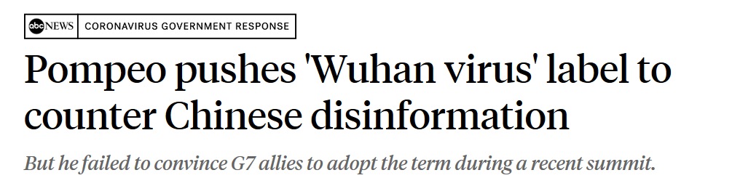
Effects of Political Rhetoric

Slide 11
Coalition Strategy: Our Four-Pronged Approach
The Stop AAPI Hate Reporting Center
Community Resources
Community Assistance
Advocacy at Local, State & National Levels

Slide 12
How we are working together
Provide Legal Assistance
Facilitate Anti-Bias Training
Conduct Community Mediation
Advocate for Policy Change
Lead Public Safety Initiatives
How you can help
Encourage your friends, neighbors, business partners, and employees to report civil right violations and incidents of hate.
Opportunities Moving Forward

Slide 13
Thank you for listening
CYNTHIA CHOI | CHINESE FOR AFFIRMATIVE ACTION
CCHOI@CAASF.ORG
MANJUSHA KULKARNI
ASIAN PACIFIC POLICY & PLANNING COUNCIL
MKULKARNI@A3PCON.ORG
AN INITIATIVE BY

